Slide 1


Green Pace
Security Policy Presentation
Developer: Cortney Messinger
CS 405 – Project Two
Security Policy Implementation
02/15/2026

Slide 2

OVERVIEW: DEFENSE IN DEPTH
• Purpose of the Security Policy • Standardized Secure Coding Practices • Defense-in-Depth Strategy • Integration into DevSecOps
Needed to standardize secure practices as the development team scales.

Slide 3
THREATS MATRIX
• Injection & Memory = Highest Risk • Arithmetic & Type = High but lower exploitability • Assertions & Randomness = Medium
• Level 5 items can cause breach/RCE or systemic outage
Impact \ Likelihood | Low | Medium | High (Likely)
High Impact | — | STD-001 (Data Type) STD-002 (Overflow) STD-003 (String) STD-007 (Exceptions) STD-008 (Concurrency) – Level 5 (higher risk) STD-009 (I/O Format Strings) | STD-004 (SQL Injection) STD-005 (Memory Protection)
Medium Impact | — | STD-006 (Assertions) STD-010 (Secure Randomness) | —
Low Impact | — | — | —
Impact = Severity | Likelihood = Probability of exploit | Level = Overall risk (1–5)
Fix order: STD-004/005 → STD-008 → remaining Level 4 → Level 3

Slide 4
10 PRINCIPLES
Validate Input Data → STD-001/002/003/004/009
Heed Compiler Warnings
Architect for Security
Keep It Simple
Default Deny
Least Privilege
Sanitize Data
Defense in Depth
Quality Assurance
Secure Coding Standards
Each coding standard maps to one or more principles.
Grounded in SEI CERT Secure Coding Framework

Slide 5
CODING STANDARDS
Priority Order:
SQL Injection (STD-004)
Memory Protection (STD-005)
Concurrency (STD-008)
String Safety (STD-003)
Integer Overflow (STD-002)
Data Type Safety (STD-001)
I/O Safety (STD-009)
Exception Safety (STD-007)
Assertions (STD-006)
Secure Randomness (STD-010)
Ranked by exploitability + impact + remediation cost (risk level)

Slide 6
ENCRYPTION POLICIES
Encryption at Rest → AES-256
Encryption in Flight → TLS 1.3
Encryption in Use → Secure memory / protected runtime
Key management required → Keys stored/managed via approved key management process

Slide 7
TRIPLE-A POLICIES
Authentication
Strong identity verification
Authorization
Role-Based Access Control
Accounting
Logging & auditing of:
– Logins
– Database changes
– Access levels
– File access
– Logs are tamper-resistant and access-controlled

Slide 8
Unit Testing
Integer Overflow or SQL Injection
- Test 1 Does the system detect integer overflow?
- Test 2 Does valid arithmetic execute correctly?
- Test 3 Are boundary values handled safely?
- Test 4 Does invalid negative input fail safely?

Slide 9
Test 1 Does the system detect integer overflow?
Input: Max unsigned int + 1
Expected: Exception thrown
Result: PASS
Next step: How to take it further

Slide 10
Test 2 Does valid arithmetic execute correctly?
Input: Safe addition
Expected: No exception
Result: PASS
Next step: add fuzz/boundary cases

Slide 11
Test 3 Are boundary values handled safely?
Input: Maximum – 1
Expected: Success
Result: PASS
Next step: test multiple integer types

Slide 12
Test 4 Does invalid negative input fail safely?
Input: Negative to unsigned
Expected: std::invalid_argument
Result: PASS
Next step: integrate into CI pipeline gate
These tests were implemented using the Microsoft C++ Unit Testing Framework within Visual Studio.

Slide 13
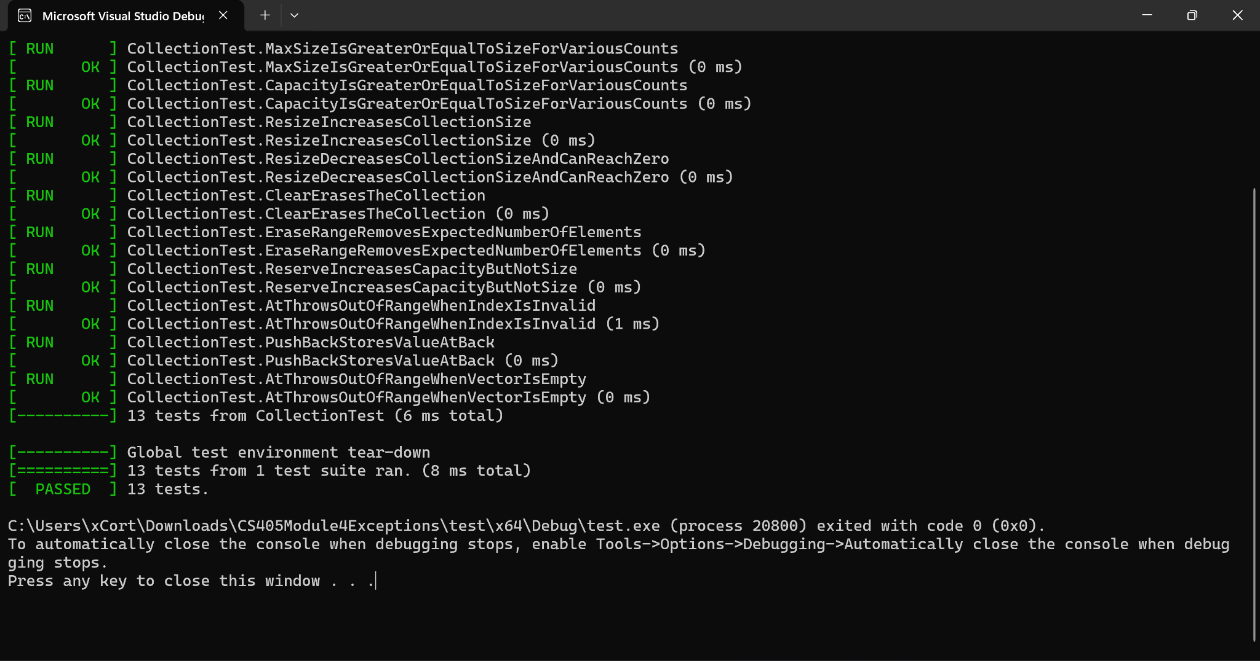
Unit Test Execution Results – Visual Studio
All four positive and negative tests executed successfully.
All 13 security validation tests executed successfully
Negative tests verified exception handling for unsafe inputs

Slide 14
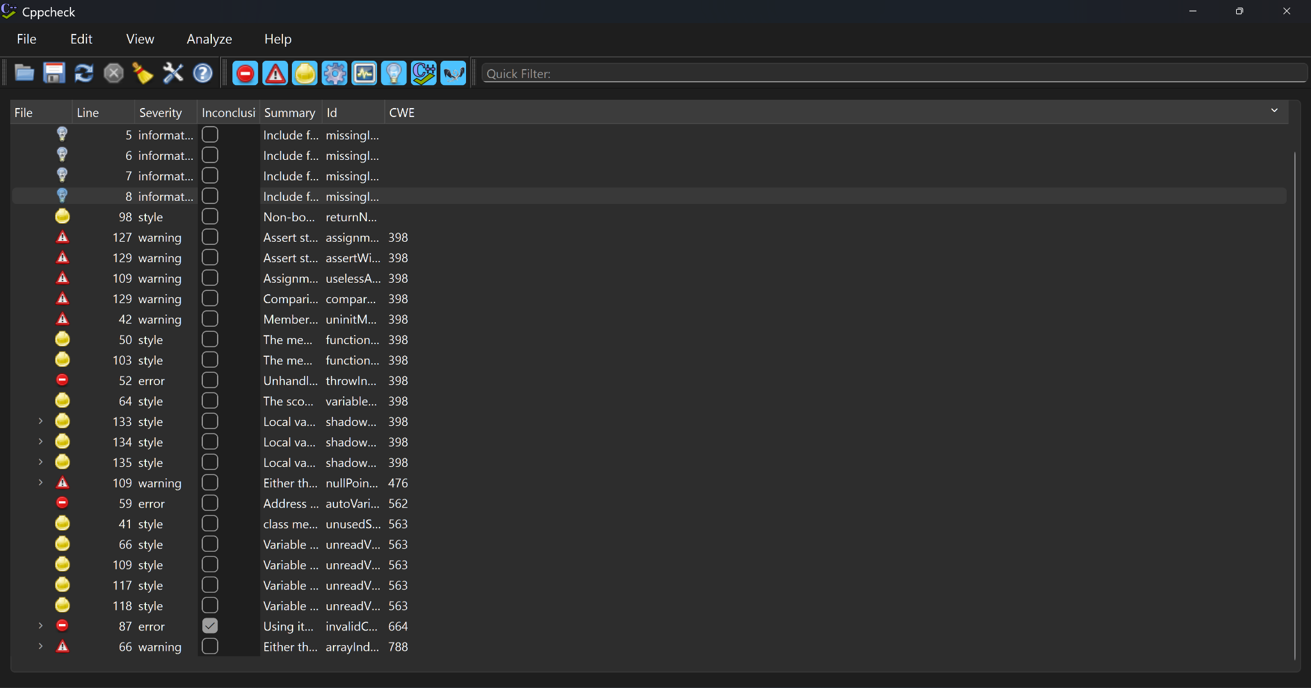
Automation / External Detection
These findings were analyzed and either remediated or documented as non-security-critical style issues
Cppcheck Static Analysis – Detected null pointer, invalid conversion, and memory safety risks.
Cppcheck detected potential null pointer, uninitialized variable, and invalid conversion risks
Findings demonstrate automated detection of memory safety and data validation issues before runtime

Slide 15

AUTOMATION SUMMARY
Static analysis detected narrowing conversion and arithmetic overflow risks before runtime.
Compiler warnings treated as errors during Create stage

Slide 16
TOOLS
Plan → Create → Verify → Pre-Production → Release → Detect → Respond → Adapt
Security Tools:
Static analysis during Create
Unit tests during Verify
Security scans in Pre-Production
Monitoring during Detect

Slide 17
RISKS AND BENEFITS
Act Now:
Reduce breach risk
Improve compliance
Lower long-term cost
Reduces technical debt and audit exposure
Wait:
Increased exposure
Legal risk
Higher remediation cost

Slide 18
RECOMMENDATIONS
Recommendations:
Continuous training
Annual policy review
Mandatory secure code reviews
CI gate blocks merge on Level 5 findings
Formal exception approval via CISO

Slide 19
CONCLUSIONS
• Continue enforcement of SEI CERT C++ Secure Coding Standard • Require automated static analysis in all builds • Mandate secure code reviews before merge • Implement annual security training for developers • Conduct annual policy review and risk reassessment • Expand monitoring and incident response automation

Slide 20
REFERENCES
OWASP Foundation. (2023). OWASP Top 10. https://owasp.org
SEI. (2016). CERT C++ Coding Standard.
NIST. (2022). Digital Signature Standard.

